Slide 1
Fundraising Anniversary Campaign 2018

Slide 2
Campaign objectives
Bring 650 new recurrent individual donors in 2018
Attract new corporate partnerships

Slide 3
The Context
SOS Satele Copiilor has a low national awareness
Few understand why we exist and what we do
Large development and communication investments from leading NGOs on the segment of children
Recent huge success with Magic Camp campaign
People believe we have something to do with the countryside

Slide 4
PREMISE
The destiny of SOS Children's Villages residents are a dramatic theme. It can make you feel a whole range of reactions, ranging from pity, compassion, to hope or admiration.

Slide 5
But the main obstacle to an effective fundraising campaign is that
PEOPLE DO NOT FULLY IDENTIFY WITH THESE CHILDREN.

Slide 6
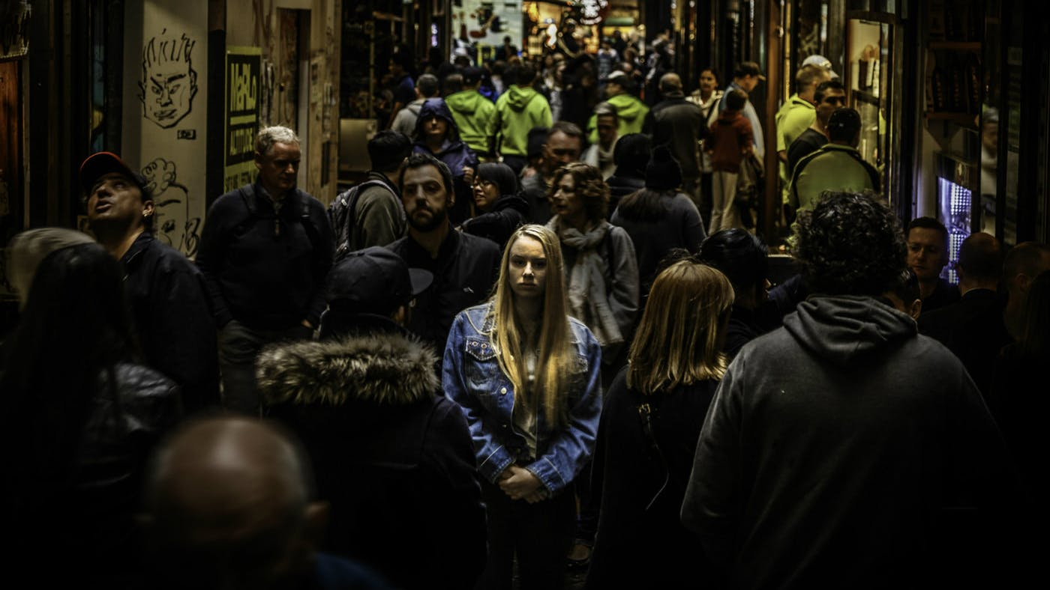
In other words, there is no direct emotional connection between potential donors and the children from SOS Children's Villages. It is not the kind of situation in which one can find himself and say THAT MIGHT HAPPEN TO ME.

Slide 7
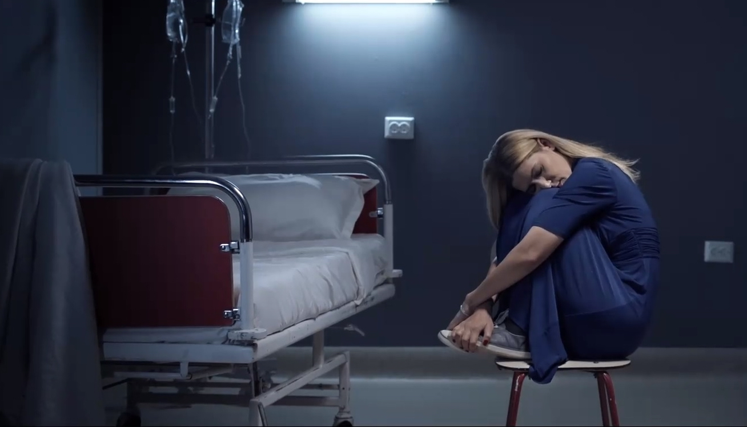
The most successful fundraising campaigns use as a trigger the fact that any donor might find himself in need of the money he is donating some day - see the success of the MagicHome Romanian campaign as all those who donated were able to project themselves in the position of a parent near his suffering child’s bed.

Slide 8
SO WHAT CAN WE DO FOR SOS CHILDREN VILLAGES?
We have to find that something that makes potential donors identify with these children, really empathize with them, and really want to help.

Slide 9
CREATIVE ROUTE

Slide 10
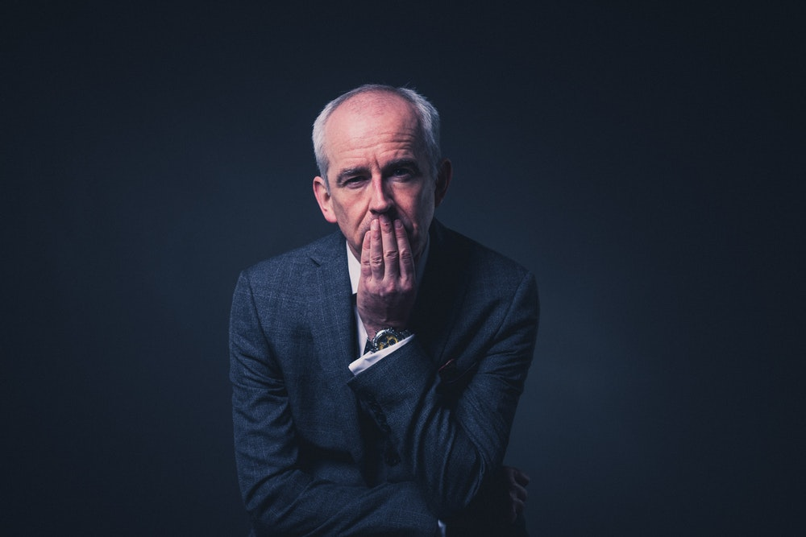
INSIGHT
Everyone wishes that at one point they would have did things differently. Few people have no regrets and even less when asked what they would change about their life, they would say they would not change anything. Everybody would like, in one situation or another, to turn back time and change they way they acted in a certain situation.
Receiving a second chance to do things differently.

Slide 11
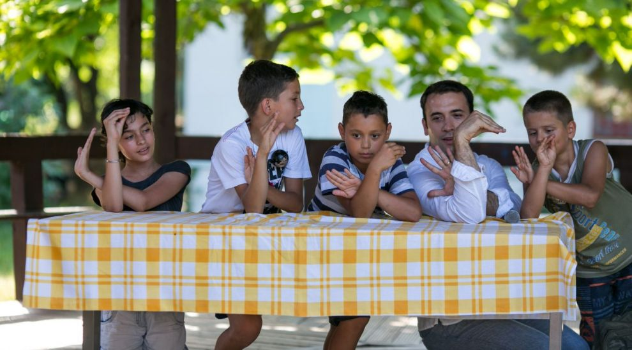
This is exactly what SOS Childrens’ Villages represent for the all its residents: a second chance. If their birth in their natural family was their first chance – unfortunate first chance – THEIR ARRIVAL IN AN SOS VILLAGE IS THEIR SECOND CHANCE to a better life. Proof for this is the fact that 90% of them manage to successfully reintegrate in society.

Slide 12
CONCEPT
FOR 25 YEARS WE OFFER CHILDREN A SECOND CHANCE.

Slide 13
We need to mark the anniversary of SOS and use the opportunity to create awareness on what are the results of SOS.
To do that all materials this year will be branded with the anniversary logo and an RTB stamp

Slide 14
CAMPAIGN
The SOS Children’s Villages campaign will try make people donate by telling them of their own life moments when they wished they had received a second chance to do a thing differently, bringing to light THE REGRET OF NOT RECEIVING IT.

Slide 15
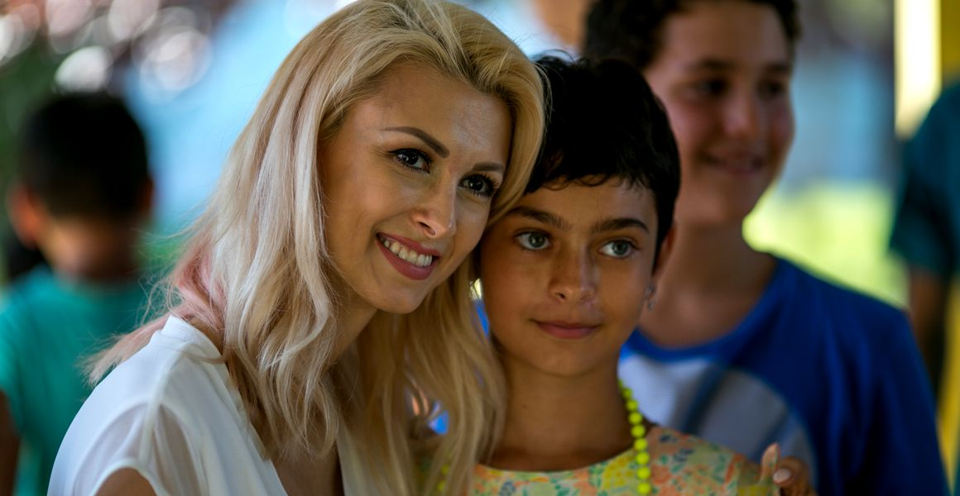
Even if for most people it is very hard to receive a second chance to change or do things differently, our campaign will focus on telling potential donors that IT IS VERY EASY FOR THEM TO GIVE A SECOND CHANCE TO THE CHILDREN OF SOS CHILDRENS’ VILLAGES TO A NORMAL LIFE.

Slide 16
HEADLINE
It is very hard to receive a second chance.
But it is very easy to give it.

Slide 17
KV

Slide 18
TVC
After a first talk with the director the shootings will take place in a real scenery, with celebrities telling real stories. They will donate a true regret from their life, when they wished they got a second chance, to the SOS campaign in order to convince people to donate.
The celebrities tell in front of the camera their biggest regrets, the ones for which they would have liked a second chance. Each character will be shot in a representative environment for their careers.

Slide 19
The script below is presented as a model, as the stories will be real moments from each celebrity life.
In the scene appears a mature character (about 50 years old) dressed in a suit with a book in his hand. Addresses the camera:
"I'm a banker. A pretty good one, I think. But I always enjoyed reading and writing. I kept a diary once ... “
The next character that appears is a young woman who gets in the light with a puppy in her arms. Talks to the camera:
"I was driving, I was going to the sea side and I saw a puppy on the side of the road. He seemed hungry, scared ... I could have stopped. “
We're going to the next character. A woman about 60 years old, elegant, but with that shadow of sadness on her face. Appears in the light holding a stage microphone.
"I was always told that I have a beautiful voice. I sang for friends, sometimes. But never on a stage“
A young man now appears holding flowers in his hand.
She left. For good. We quarreled and, in the morning, when I woke up, she was not there anymore. "

Slide 20
Young woman reappears with the puppy in her arms:
"If I saw that puppy again, I would stop the car and take it home“
We see the gentleman with the book in his hand:
"If I could do it all over again, I would start writing“
We see the 60 year old lady:
“If I could choose again, I would not miss the opportunity to study music”
Finally, we also see the young man left by the girlfriend, with the flowers in his hand.
“If I could give back time, I would know how to make her stay”.

Slide 21
The light on the face of the young man with the flowers turns off. On this dark background appears the text:
IT IS VERY HARD TO RECEIVE A SECOND CHANCE.
The light turns on and now we see the face of a child from SOS Children's Villages. Now the text appears on the screen
BUT IT IS VERY EASY TO GIVE IT.
Donate 2 EURO per month for SOS Children's Villages and help children get a second chance.
Send the word MOM via SMS to 8844.
Logo SOS Children’s Villages.

Slide 22
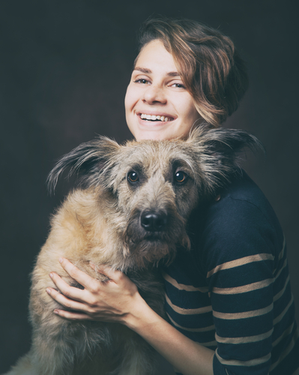
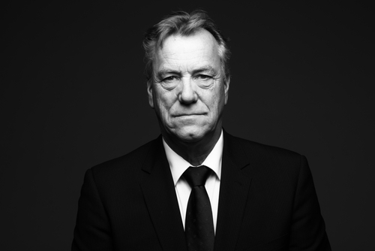
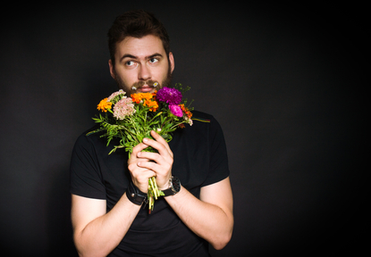
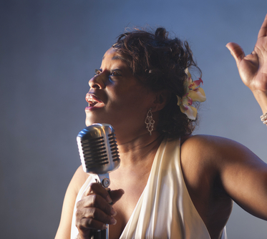
IT IS VERY HARD TO RECEIVE A SECOND CHANCE.

Slide 23
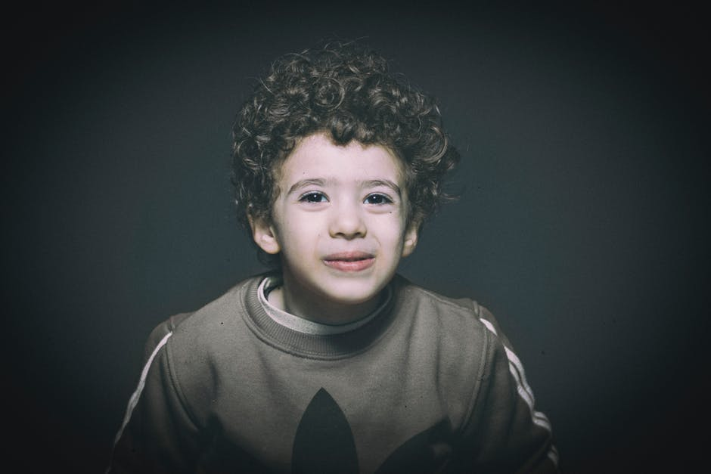
BUT IT IS VERY EASY TO GIVE IT.

Slide 24
Our list of potential celebrities
1. Athletes
Catalina Ponor
Claudiu Keseru
Florin Gardos
Cristi Chivu
Nadia Comaneci
Cristina Neagu
Alex Chipciu
Balint
Stelea
Horia Tecau
Mihai Leu
2. TV/Music/Theatre
Andi Moisescu
Marian Ralea
Horatiu Malaele
Oana Pellea
Mihai Bobonete
Valentin Teodosiu
Marius Vizante
Dan Negru
Andreea Esca
Catalin Maruta
Andra
Loredana
Busu
Corina Caragea
Ramona Paun
Dana Rogoz
3. Wishful thinking
Florin Calinescu
Mihaela Radulescu
Marius Manole
Bartos
Stefan Banica Jr.
Andreea Marin
Dan Bittman
Calin Goia
Dragos Bucur
Andi Vasluianu
Vancica
Ada Milea

Slide 25
NICE CONCEPT BUT …
People need pragmatic reasons for which they donate money. So we will translate this second chance in each piece of the campaign.
It is very easy to give a second chance to ….. A normal life
It is very easy to give a second chance to ….. A birthday party
It is very easy to give a second chance to ….. Not going to bed hungry

Slide 26
A SECOND CHANCE to:
have a real home
wear a pink backpack
have a new t-shirt
not be looked at with pity
hear an encouragement
go rollerblading with friends
a birthday party
brothers and sisters
not going to sleep hungry
have a family
a real football
making friends
call his mother
learn the alphabet
not be ignored

Slide 27
Campaign overview
Campaign Landing Page
Radio
(Europa FM Partnership)
Online:
- Facebook
- Google
- Partners’ Assets
- Influencers
PR
Corporate Partnerships
TV
PRO TV partnership
PR appearances
The central piece of the campaign will be a dedicated landing page, where we will have the entire content pool.

Slide 28
Campaign Landing Page
The platform will host each celebrity regret
Besides the celebrities in the TVCs, we will gather also text stories from other influencers and celebrities to join our campaign by donating a true regret from their life
Every story will visually represent the concept, by organizing the content in 2 columns the parallel between:
IT IS VERY HARD TO …. BUT IT IS VERY EASY TO GIVE …
Donations button will be visible THROUGHOUT the landing page
Landing page name domain proposals available:
Sansa2.ro
a2asansa.ro

Slide 29
Radio
Use the existing partnership with Europa FM radio to get broadcasting time for the campaign
The TVCs will be suitable for radio broadcasting too because we will be able to edit the VOs pending on the duration we can air on radio
Europa FM’s hosts can also join the campaign and share their biggest regrets

Slide 30
TV Partnership
We propose a TV partnership with PRO TV that should include exposure for SOS campaign on TV and online. A good asset to create this deal would be a corporate partner of SOS that is willing to join the project. The TV shows that are of interest to us are the ones in Daytime (07.00 am – 16.00 pm) and Access Time (16.00 – 19.00).
TV should be a special project – “Pastila A doua sansa” – it means that every guest of Maruta show (eg.) will be kindly asked to donate a regret followed by call to action to donate
During this part of the TV show on the screen you will see the SMS number to donate for SOS Children’s Villages, together with “with the support of…” and the corporate partner’s name/logo.
All the videos with the guests answering this question can become a special video section on the show’s website, where a corporate SOS partner can receive exclusive visibility
This will ad extra content for the campaign and extra visibility
All the video content from the TV show, also receives posts on the show’s social media accounts.

Slide 31
PR
Using as a leverage the fact that celebrities are donating regrets can bring many TV and press appearances
All press connections of SOS Romania will receive press releases each time a new celebrity joins the campaign
All TV stations will receive video content with celebrities joining the campaign
All video content created for this campaign will be suitable, with little changes for all media formats

Slide 32
Digital channels
The main communication channel is online. We will use the content we create around the campaign and with the main call to action to “Donate”.
The online channels we will use, will be:
SOS Digital Assets
Partnerships with influencers (TVCs and extra celebrities) – social media communities
Digital publishers with a wide range of online assets so that we can reach a vast majority of the target (eg: mediafax.ro)
Paid Media
Facebook ads
Google search Ads from the Google Grant

Slide 33
Online publisher partnership
We propose using news.ro existing partnership or Mediafax as a strategic partner because they are news agencies that all press use as a source and we maximize our chances for general publishers like hotnews.ro, adevarul.ro to have access and use our content
The promise of the partnership is that we offer exclusivity per celebrity (some will be only on news.ro, some only on mediafax.ro). All campaign content with celebrities will be shared first with them, so that they can use it for traffic reasons.
Only after they publish it, it becomes available on our landing page as well
This way, we can make sure that our campaign content will get the visibility we need.

Slide 34
Influencers
We will choose celebrities from different domains (eg. sports, actors, musicians, etc.) so that we can cover a wide range of interests from publishers and target audience
Influencers have to share the video content or the multimedia article on their social media accounts
Where we can not have video content, we will create text articles to share their regrets on our landing page

Slide 35
Facebook Ads
During the TV appearances on TV shows of the campaign we will have an ad running encouraging people to donate;
After each TV show, we will use the video from TV to encourage people to donate and gain visibility and credibility;
Custom audiences – using lookalike audience starting from the donor data base;
Using each celebrity story as an ad to target fans of that specific celebrity with the call to action “It is very easy to give a second chance. Donate”
Different ads and messages segmented by the following large groups:
Romania
Romanians living outside Romania
Parents
Millennials

Slide 36
Google Adwords
Google Adwords campaigns - Grant
General message of the Brand Campaign
Punctual messages with each celebrity regret that joins the campaign
Retargeting:
New users - who interacted with the ads and the site for the first time
Recurring users - who are not on the first visit to the site but have not yet donated.

Slide 37
Content digital journey
Publisher partner
Facebook Ad
Google Adwords
Publisher Partner social accounts
Other Press
Campaign Landing Page
SOS Facebook

Slide 38
SOS Assets
8k visits for Future calls Present Campign
23k fans
2k average reach per post
Facer team on the streets
15k email addresses from individual donors;

Slide 39
SOS Assets
Newsletter – weekly newsletter to donors with new content campaign and donation call to actions
Facebook – all campaign content will receive at least one Facebook post on the SOS page. It will be our main fundraising tool
Website – all campaign content will be hosted on the landing page of the campaign that will redirect to the SOS website
Facers – the team will have special T-shirts with the campaign message during the campaign when going out for donations

Slide 40
Corporate Partners
Existing corporate partners
Propose an idea to hem – the partners’ company CEO donates a regret to our campaign as well
This will give us relevant content for financial publications and also a context for:
Digital assets of partners – we can ask their help to post our campaign message on their social media accounts
Internal newsletter – the HR department of our partners can send an internal newsletter encouraging their employees to donate for the SOS cause
Potential coporate partners
Praktiker’s slogan is “From house to home” and it is a great match with SOS children’s villages mission and needs. We recommend to submit a project to start working with them - WIP

Slide 41
Type of donation communicated per channel
SMS donations
Radio
TV
Online donations
Facebook (different ad for SMS donations for testing)
Google
Facebook (different ad for SMS donations for testing)
Newsletter

Slide 42
Special Contexts
International Day of Families 2018 – May 15th
We will mark it by launching the campaign on Family Day
Children’s Day – June 1st
We will gather content around the Second Chance concept from the celebrities that joined the campaign, by asking: What is you biggest childhood regret?
Back to school – Sep 7th
We will mark it by starting the second flight of the campaign

Slide 43
Campaign timing - flights
Campaign | May | June | July | August | September | October
Brand | 1st flight May 15th – June 22nd |  |  |  | 2nd flight Sep 7th – Oct 26th
International Day of Families | May 15th
Children’s Day |  | June 1st
Back to school |  |  |  |  | Sep 10th
Anniversary Event |  |  |  |  |  | Oct 23rd

